Slide 1



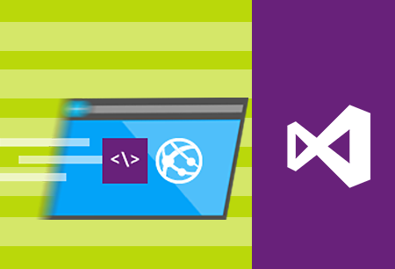
MVC Architecture Components
Controllers, views, Razor HTML helpers and tag helpers, model binding and validation
C# MVC Frameworks
SoftUni Team
Technical Trainers
Software University
http://softuni.bg

Slide 2
Questions
sli.do #csharp-web

Slide 3
Table of Contents
Controllers
Views
HTML helpers
Tag helpers
Display / editor templates
Model binding and validation
Data annotations
Model state

Slide 4

ASP.NET Core MVC Controllers

Slide 5

ASP.NET Core MVC Controller
A Controller is used to define and group a set of actions
An Action is a method on a Controller which handles requests
By convention, Controllers:
Are put in the Controllers folder
Inherit from the ASP.NET Core Controller class
Their class name ends with …Controller
They are decorated with the [Controller] attribute (optional)

Slide 6
Controller Essentials
The Base Controller class provides a lot of functionality
View() method – One of the most frequently used Controller class members
The controller action may or may not provide a model to the view
public IActionResult Index()
{
return this.View();
}
public IActionResult Index()
{
return this.View(userModel);
}
public IActionResult Index()
{
return this.View("Register");
}
public IActionResult Index()
{
return this.View("Register", userModel);
}

Slide 7
Useful Controller Members
Redirect() / RedirectTo…()
Redirect to a specified action
HttpContext
HTTP data (Request, Response, Session, etc.) for the currently executing action
Most of its contents are available directly as Controller members
ViewData and ViewBag
Weakly-typed data to be passed from controller to views
TempData
Data which "survives" for the next request
ModelState
State of the Model and the model-binding validation

Slide 8

ASP.NET Core MVC Views

Slide 9
View Helpers
Each view inherits from RazorPage
ViewPage has a property named Html
Its Html property has methods that return string and can be used to generate HTML
Create inputs
Create links
Create forms
@using (Html.BeginForm("Index", "Home", FormMethod.Post))
{
@Html.TextBox("username")
<input type="submit"/>
}

Slide 10

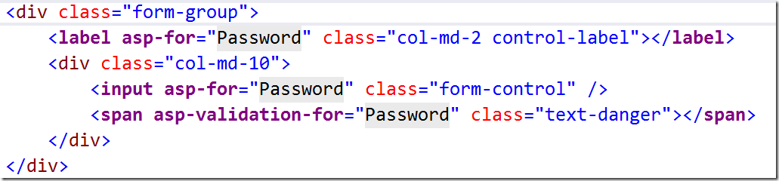
Tag Helpers
Allow us to create HTML elements with code
<label asp-for="Email"></label>
<label for="Email">Email</label>
Helpers

Slide 11
Common HTML Helpers
HTML Helper | Description
@HTML.ActionLink | Returns and anchor link
@using (Html.BeginForm) { form content } | Creates and html form
@HTML.CheckBoxFor | Creates a checkbox for a given property of the model
@HTML.Display\For | Displays the name of a given property
@HTML.Editor\For | Creates and editor\for a given property
@HTML.Label\For | Creates a label\for the given property

Slide 12
Other HTML Form Helpers
HTML Helper
@Html.DropDownList\For
@Html.TextBox\For
@Html.TextArea\For
@Html.Password\For
@Html.Hidden\For
@Html.CheckBox\For
@Html.RadioButton\For
@Html.ListBox\For

Slide 13

Custom HTML Helpers
Write extension methods for the HtmlHelper
public static class HtmlHelperExtensions
{
public static IHtmlContent HelloWorld(this IHtmlHelper helper)
=> new HtmlString("<h1> Hello, World </h1>");
}
<div>@Html.HelloWorld()</div>

Slide 14
Custom Tag Helpers
<message content="Hello World!"></message>
Inherit from TagHelper
Override the Process() method
If you use properties, they're bound to tag helper attributes
public class MessageTagHelper : TagHelper
{
public string Content { get; set; }
public override void Process(TagHelperContext context, TagHelperOutput output)
{
output.Content.SetContent(this.Content);
}
}
@addTagHelper *,<assembly name>

Slide 15
Partial Views
Partial views render portions of a page
Reuse pieces of a view
Html helper – Partial
Razor partial views are still .cshtml files
Display / Editor templates
In folders /Views/Shared or /Pages/Shared
File name: <ModelType>.cshtml
@Html.Display\For(); @Html.Editor\For()

Slide 16


Model Binding & Data Validation

Slide 17
Getting Data from Request
MVC binds Request Data to the action parameters by name
For each parameter MVC will search for values in:
Form values
Route values
Query string values
MVC uses reflection and recursion to traverse the properties of complex types looking for matches

Slide 18
Custom Model Binding Behavior
[BindRequired]
Adds a Model state error if binding cannot occur
[BindNever]
Forbids binding to this parameter
[From…], where … = Header, Query, Route, Form
Specifies the exact binding source
[FromServices]
Uses DI to bind from the application services
[ModelBinder]
Used to override the default model binder with a custom one

Slide 19
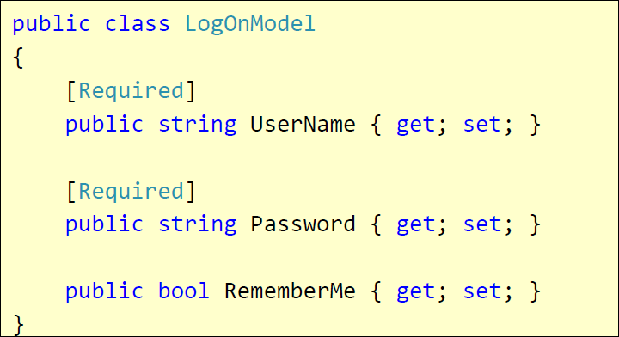
Validation with Annotations
Attributes are defined in
System.ComponentModel.DataAnnotations
Covers common validation patterns
Required
StringLength
Regex
Range

Slide 20
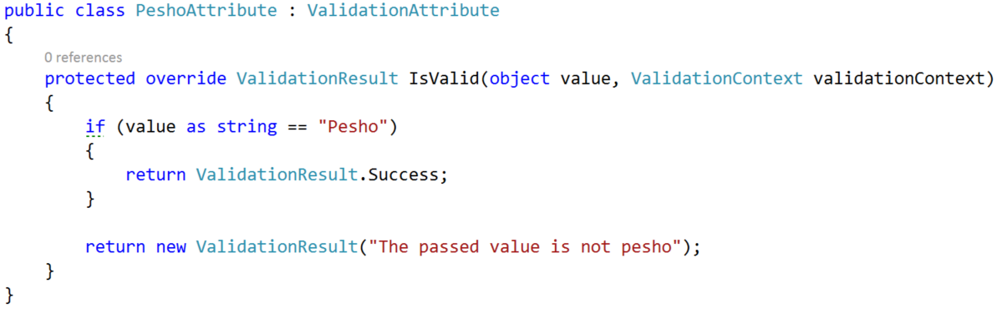
Custom Validation
Custom attributes
Inherit ValidationAttribute

Slide 21
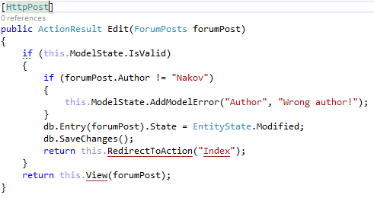
Validating Model – Controller
ModelState.IsValid will give us information about the data validation success
ModelState.AddModelError() will produce a custom error

Slide 22
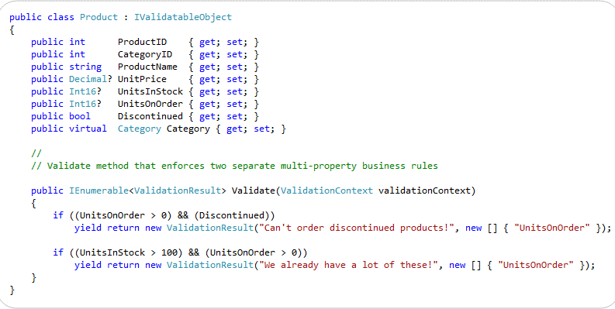
Class-Level Model Validation
Your model should implement IValidatableObject

Slide 23


Summary
Controllers
Views
HTML helpers
Tag helpers
Display / editor templates
Model binding and validation
Data annotations
Model state

Slide 24







MVC Architecture Components
https://softuni.bg/courses/asp-net-mvc

Slide 25
License
This course (slides, examples, demos, videos, homework, etc.) is licensed under the "Creative Commons Attribution-NonCommercial-ShareAlike 4.0 International" license

Slide 26





Trainings @ Software University (SoftUni)
Software University – High-Quality Education, Profession and Job for Software Developers
softuni.bg
Software University Foundation
http://softuni.foundation/
Software University @ Facebook
facebook.com/SoftwareUniversity
Software University Forums
forum.softuni.bg

